Slide 1
Python Refresher for AI

Slide 2
Functions, OOPs, and File and Error Handling

Slide 3
Lists store ordered and mutable elements with methods like append(), extend(), and pop().
Tuples are immutable sequences supporting packing and unpacking.
Dictionaries store key-value pairs with methods like get(), keys(), and items(). Nested dictionaries enable hierarchical storage.
Sets hold unique and unordered elements They support methods like union(), intersection(), and difference().
Conditional statements use if, if-else, if-elif-else, and nested-if for decision-making.
Loops include for and while, support nesting, and can include an else clause.
Notes:
Mode: Sync
Estimated duration: 5 mins
Type: Instructor-led
Instructor Note:
Quickly recap the points discussed in the previous lesson.

Slide 4
As a Python developer, you are working on a project that requires efficient code organization, reusable logic, and structured data management. Your goal is to write modular, scalable, and maintainable code using Python’s functions, object-oriented programming (OOP), generators, and file-handling techniques.
How would you decide when to use functions, OOP, or generators in your Python project? What factors influence your choice?
Notes:
Mode: Sync
Estimated duration: 10 mins
Type: Instructor-led whole group discussion
Instructor Note:
Facilitate a whole group discussion to kick off today’s lesson. Ensure that you do not spend much time discussing the answers. This slide aims to gain the learners’ attention and relate the lesson theme with relatable examples before starting with the actual lecture topic.
For a data-heavy application, generators are often the best approach for optimizing performance because they allow for lazy evaluation. Unlike functions that return entire datasets at once or OOP that creates objects consuming memory, generators yield data one item at a time, reducing memory usage and improving efficiency.
However, the choice depends on the use case:
Generators: Best for processing large datasets efficiently, as they don’t store all data in memory. Example: Streaming log files or processing big CSV files.
Functions: Useful for modularizing code and reusing logic but may increase memory usage if they return large lists.
OOP: Ideal for structuring complex applications with multiple interacting components but may add overhead when handling large-scale data.
Conclusion:
If memory efficiency is the priority, generators are the best choice. If code modularity is crucial, functions are effective. If the application requires structured, reusable components, OOP is beneficial.

Slide 5
Use functions to define reusable code, manage arguments, and control program scope effectively
Apply generators and lambda functions to process data efficiently and simplify expressions
Implement object-oriented programming to structure code using classes, objects, methods, and inheritance
Perform file-handling operations to create, read, write, and parse different file formats
Handle errors using exception-handling techniques to improve code stability and debugging
Notes:
Mode: Sync
Estimated duration: 2 minutes
Type: Instructor-led
Instructor Note:
State the learning objectives of the lesson.

Slide 6
Python Functions and Their Advantages
Notes:
Let's understand the benefits and applications of functions in Python.

Slide 7
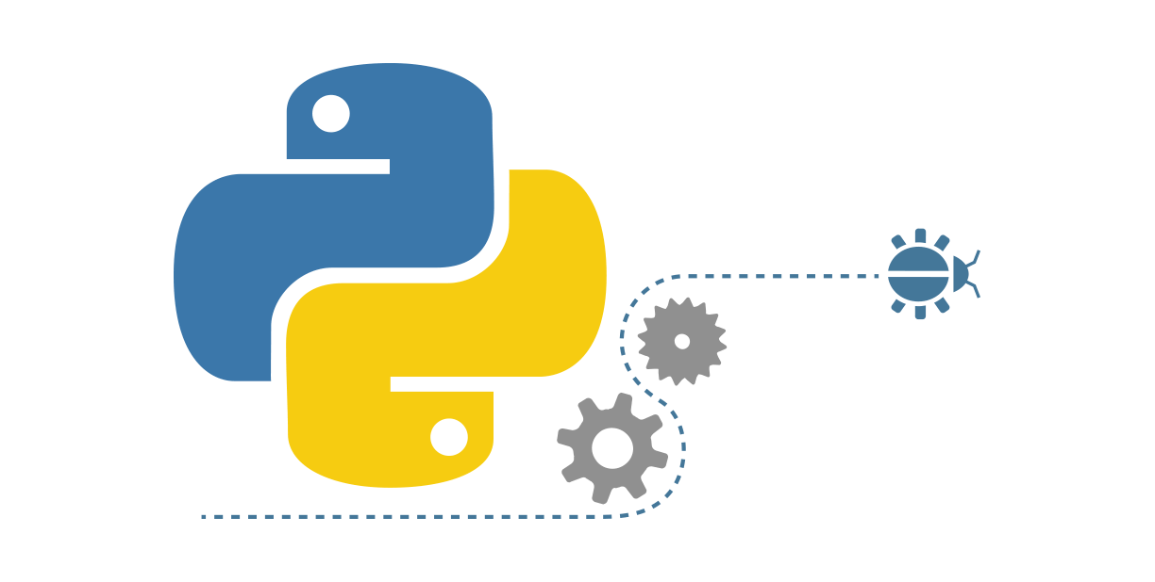
Introduction to Python Functions
A function is a collection of related statements that accomplish a specific task.
It is an organized block of reusable code.
It executes only when it is called.
Parameters are data passed into a function.
Notes:
Instructor Notes:
Functions are the primary and the most important method of code organization and reuse in Python.
Each function can have some number of positional arguments and some number of keyword arguments.

Slide 8
Functions: Advantages
1
Enables comprehensibility
Supports modularity
2
3
Enhances program quality
Promotes reusability
4
5
Improves scalability
6
Provides ease of use
Notes:
This slide is self explanatory.

Slide 9
Functions: Syntax
The basic syntax of a function in Python consists of two parts:
Function definition
A function is defined using the keyword def, followed by a function name and parenthesis.
The argument names passed to the function are mentioned inside this parenthesis.
The body of the function is an indented block of code.
01
Syntax
def myFunction(arg1, arg2):
body
Notes:
Instructor Notes: A function is usually created using the keyword ‘def’.
The outcome of a function is transmitted via a return statement, which is one of the essential features of a function. Arguments in parenthesis are basically assignments.

Slide 10
Functions: Syntax
The basic syntax of a function in Python consists of two parts:
Function call
A function can be called from anywhere in the program.
When a function is called, program control is transferred to the called function to perform the defined task.
All the necessary parameters and arguments should be passed during the function call.
02
Syntax
myFunction(arg1, arg2)
Notes:
Instructor Notes:
In Python, a function call is a way to execute a function and perform a specific task or operation. When you call a function, you provide the necessary arguments (if any) and the function's code is executed.

Slide 11
A function is defined using the keyword _____.​
func
function
def
All of the above
Notes:
Instructor Notes:
Correct Answer: C def Explanation: A function is defined using the keyword def, followed by a function name and parenthesis.​

Slide 12
Function Arguments
Notes:
Let's learn about function arguments and how they are used to pass data into functions in Python

Slide 13
Functions Arguments
Function arguments are values passed into a function as inputs for performing operations.
The features of the arguments are as follows:
Information can be passed to a function in the form of arguments.
A function may have zero to multiple arguments separated by commas.
Plan
Features
The arguments are specified and enclosed in parentheses in the function definition immediately after the function name.
The arguments can be data values, objects, or functions.
Notes:
This slide is self explanatory.

Slide 14
Functions: Argument Matching
Arguments in Python can be matched by position or name.
Positional arguments must be in the same order as in the function definition.
Keyword arguments are referenced by name and may be in any order.
Positional and keyword arguments can be mixed in a function call.
Note
Arguments in a function may also be defined with a default value.
Notes:
Instructor Notes:
Positional arguments must be provided in the same order as defined in the function's parameter list.
Keyword arguments are referenced by name and can be provided in any order.

Slide 15
Implementing Function and Argument Matching
05
Overview:
This demonstration covers creating functions and passing arguments in Python. You will learn how to define functions, pass different types of arguments, perform argument matching, and call functions to display results.
Note:
Please download the demo document from the Reference Material section to perform step-by-step execution.
Notes:
Instructor Notes:
Please demonstrate the actions specified on the slide. Additionally, encourage the learners to actively participate by performing the tasks along with you during the demonstration.
For further guidance, you can refer to the elaborated demo document.
Objective: In this demonstration, you will learn to create a function with arguments.
Steps to perform:
Step 1: Create a function
Step 2: Pass arguments to the function
Step 3: Perform argument matching
Step 4: Call the function and display the results

Slide 16
Functions: Arbitrary Arguments
Python allows passing variables with multiple arguments using special symbols.
The symbols used to pass arguments are:
*args
Non-keyword arguments
**kwargs
Keyword arguments
Note
These notations are used when the number of arguments to be passed to the function is uncertain.
Notes:
This slide is self explanatory.

Slide 17
Functions: Arbitrary Arguments
The types of arbitrary arguments are explained below:
Non-keyword arguments | Keyword arguments
The symbol * captures a variable number of arguments. | Keyword arguments use the ** symbol. Conventionally, kwargs defines keyword arguments.
Conventionally, args defines non-keyword arguments. | A keyword argument allows you to name the variable before passing it to the function.
he function unpacks these arguments as a list. | Keyword arguments function like a dictionary, mapping each value to its keyword.
Notes:
This slide is self explanatory.

Slide 18
Implementing Arbitrary Arguments
05
Overview:
This demonstration covers using arbitrary arguments in Python functions. You will learn how to define functions that accept a variable number of arguments, pass multiple arguments dynamically, and call functions to display results.
Note:
Please download the demo document from the Reference Material section to perform step-by-step execution.
Notes:
Instructor Notes:
Please demonstrate the actions specified on the slide. Additionally, encourage the learners to actively participate by performing the tasks along with you during the demonstration.
For further guidance, you can refer to the elaborated demo document.
Objective: In this demonstration, you will learn to use arbitrary arguments.
Steps to perform:
Step 1: Define a function that takes arbitrary arguments
Step 2: Pass arguments to the function
Step 3: Call the function and display the results

Slide 19
return Statement
Notes:
Let's understand how the return statement is used to send a result back from a function

Slide 20
Functions: return Statement
The return keyword passes values back to the function call.
If the return statement is not used, Python returns None by default.
After the return statement is executed, no further statements of the function are executed.
A function can return none, multiple values, or data objects.
Notes:
This slide is self explanatory.

Slide 21
Implementing return Statement
05
Overview:
This demonstration covers using the return statement in Python functions. You will learn how to define functions with arguments, return values from functions, and call functions to display results effectively.
Note:
Please download the demo document from the Reference Material section to perform step-by-step execution.
Notes:
Instructor Notes:
Please demonstrate the actions specified on the slide. Additionally, encourage the learners to actively participate by performing the tasks along with you during the demonstration.
For further guidance, you can refer to the elaborated demo document.
Objective: In this demonstration, you will learn to use the return statement.
Steps to perform:
Step 1: Define a function with arguments
Step 2: Use the return statement to return values when the function is called
Step 3: Call the function and display the results

Slide 22
Scope of a Variable
Notes:
Let's understand the scope of a variable in Python.

Slide 23
Function: Scope
Scope in programming defines the environment where the variables can be accessed and referenced.
Features
If a value of a variable is to be retrieved in a function, it searches for the global environment of each package on the search list.
It defines the functional range of any variable or function.
Notes:
Instructor Notes: Variables have a specific scope that determines where they can be accessed and used. The scope is usually defined by the block of code in which the variable is declared or defined.

Slide 24
Function: Scope
There are two types of scope:
Global scope | Local scope
Variables and functions defined outside of all classes and functions have global scope. | Variables or functions defined inside a function block, including argument names, are local variables.
It allows variable values to be used or functions to be called from anywhere in the file in the program. | It can be accessed only inside the function block.
Notes:
This slide is self explanatory.

Slide 25
Generators Function
Notes:
Let's investigate how generator functions work in Python

Slide 26
Function: Generators
Generators are a special function supported in Python that returns an iterator object with a sequence of values.
A generator uses a yield statement instead of a return statement.
Features
A generator object can be iterated only once.
A function with a yield statement is termed a generator.
Notes:
Instructor Notes:
In Python, a generator is a special type of function that generates a sequence of values, one at a time, instead of returning a single value like a regular function. It allows you to create iterators in a more concise and memory-efficient way.

Slide 27
return vs. yield Statement
The differences between the return and yield statements are given below:
return statement
yield statement
The return statement implies that the function is returning control of execution to the point from where the function is called.
The process destroys the local variables and values generated.
The yield statement implies that the transfer of control is temporary.
It does not destroy the states of the function’s local variables.
Notes:
Instructor Notes:
The return statement is used in regular functions to provide a final result and terminate the function.
The yield statement is used in generator functions to produce a sequence of values and allows the function's execution to be paused and resumed.

Slide 28
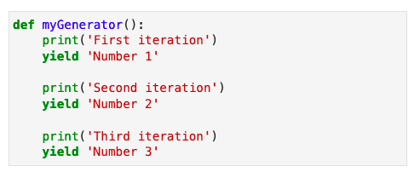
Generator: Example
Here a generator function is defined that yields three values:
Note
In place of multiple yield statements, a loop can also be used inside the function to generate the values.
Notes:
This slide is self explanatory.

Slide 29
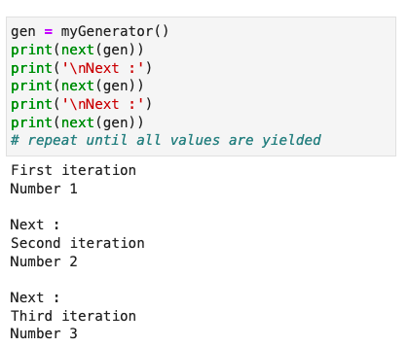
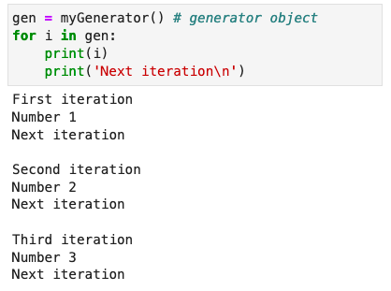
Ways to Use a Generator
The generator function can be used in two ways:
It can be used with the built-in next function.
It can be used with a for loop as an iteration object.
Notes:
This slide is self explanatory.

Slide 30
Lambda Functions
Notes:
Let's learn how to use lambda functions in Python.

Slide 31
Lambda Functions
Python lambda functions are anonymous functions defined using the keyword lambda.
A lambda function may have any number of arguments but contains only one expression.
Features:
The lambda functions are syntactically restricted to only a single expression, which is evaluated and returned.
A lambda function can be defined without assigning a variable or explicitly calling it.
Syntax: lambda arguments: expression
Notes:
Instructor Notes:
Python lambda functions are anonymous functions defined using the lambda keyword. They are used for small and simple operations and can be defined inline without a formal function name.

Slide 32
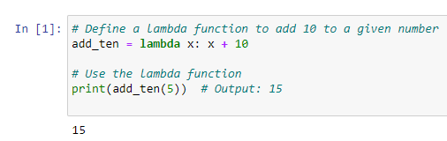
Lambda Function: Example
This example demonstrates how to use a lambda function in Python to add 10 to a given number:
Notes:
add_ten = lambda x: x + 10: This line defines a lambda function that takes one argument x and returns x + 10.
print(add_ten(5)): This line calls the lambda function with the argument 5. The function adds 10 to 5 and returns 15, which is then printed.

Slide 33
Function Types
Notes:
Let's understand the different types of functions in Python

Slide 34
Types of Functions
Functions can be of two types:
Built-in functions | User-defined functions
Built-in functions are predefined functions in the programming framework. | Python supports the creation of customized, user-defined functions to perform specific tasks.
Python has basic built-in functions, such as len(), sum(), type(), slice(), next(), help(), and format(). | A user can give any function a name with any number of arguments.
Notes:
Instructor Notes:
Built-in Functions: Pre-defined functions in Python like print(), len(), and type().
User-Defined Functions: Functions created by the programmer using the def keyword.

Slide 35
Functional Programming Implementation
Notes:
Let's learn how to implement functional programming in Python

Slide 36
Functional Programming Methods
These built-in functions facilitate functional programming in Python, which uses methods to define computations.
Filter function
Syntax: filter(func, iterable)
Map function
Syntax: map(func, iterable)
Reduce function
Syntax: reduce(func, iterable)
Types
The map and filter functions are basic built-in functions, whereas the reduce function is part of a module named _functools.
Notes:
Instructor Notes:
The map() and filter() functions are basic built-in functions in Python that are commonly used for data manipulation and transformation.

Slide 37
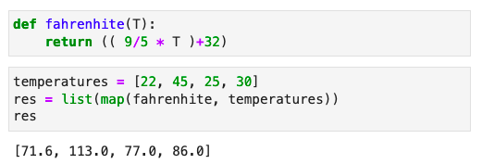
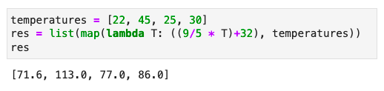
map()
A map function can apply a function to each element of an iteration object.
Example
The map function takes two arguments: a function and an iterable object.
It applies the given function to all elements of the given iteration object.
It generates an iterator, which can be converted to a list.
It can also use the lambda function for implementation.
Notes:
This slide is self explanatory.

Slide 38
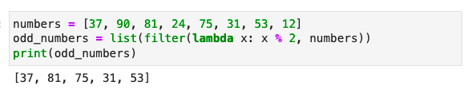
filter()
A filter function filters data based on a condition defined in the function.
Example
The filter function also takes a function and an iterable object and applies the function to each element of the iteration object.
The given function should return a Boolean value.
Notes:
This slide is self explanatory.

Slide 39
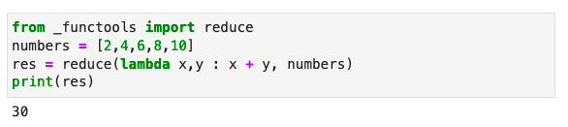
reduce()
A reduce function implements the mathematical technique of folding on an iteration object.
Example
The reduce function uses a given function to process an iterable object.
The reduce function applies the function continually to each element of the iterable object and produces a single cumulative value.
Notes:
This slide is self explanatory.

Slide 40
Implementing Generators, Lambda, and Built-in Functions
05
Overview:
This demonstration covers generators, lambda functions, and built-in functions in Python. You will learn how to define generator functions, use lambda expressions, and apply built-in functions like map() and filter() to process data efficiently.
Note:
Please download the demo document from the Reference Material section to perform step-by-step execution.
Notes:
Instructor Notes:
Please demonstrate the actions specified on the slide. Additionally, encourage the learners to actively participate by performing the tasks along with you during the demonstration.
For further guidance, you can refer to the elaborated demo document.
Objective: In this demonstration, you will learn to use the generators, lambda, and built-in functions
Steps to perform:
Step 1: Define a generator function that yields values one by one
Step 2: Introduce the lambda function and use it with built-in functions
Step 3: Apply built-in functions like map(), filter(), or reduce() to process lists efficiently

Slide 41
Object-Oriented Programming
Notes:
Let's look into what makes Python an Object-Oriented Programming (OOP) language.

Slide 42
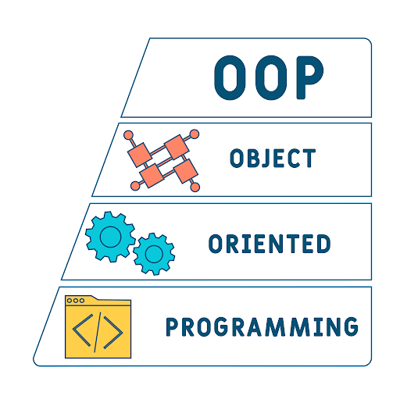
What Is OOP?
Object-Oriented Programming (OOP) refers to languages that use objects in programming. It aims to implement real-world entities such as inheritance, information hiding, and polymorphism.
Notes:
Instructor Notes:
Object-oriented programming: As the name suggests, Object-Oriented Programming or refers to languages that use objects in programming. Object-oriented programming aims to implement real-world entities like inheritance, hiding, polymorphism, etc. OOP in programming. The main aim of OOP is to bind together the data and the functions that operate on them so that no other part of the code can access this data except that function.

Slide 43
OOP: Concepts
The four concepts of object-oriented programming are:
Encapsulation
Inheritance
Polymorphism
Abstraction
Notes:
Instructor Notes:
OOP Concepts:
Abstraction
Encapsulation
Inheritance
Polymorphism

Slide 44
Objects and Classes
Notes:
Let's understand the concept of objects and classes in Python.

Slide 45
Objects
An object represents a real-world entity that can be distinctly identified. It consists of the following components:
Identity: It reflects the unique name of an object.
01
State: It reflects the properties of an object.
Components of an object
02
Behavior: It reflects the response of an object to other objects.
03
Notes:
Instructor Notes:
An object is an instance of a class
Object: It is a basic unit of Object-Oriented Programming and represents real-life entities. A typical Java program creates many objects, which as you know, interact by invoking methods. An object consists of:
State: It is represented by the attributes of an object. It also reflects the properties of an object.
Behavior: It is represented by the methods of an object. It also reflects the response of an object to other objects.
Identity: It gives a unique name to an object and enables one object to interact with other objects.
Example of an object: dog

Slide 46
Objects: Example
Object: Dog
Identity | State or Attribute | Behavior
Name of the dog | Breed | Bark
 | Age | Sleep
 | Color | Eat
Notes:
Instructor Notes:
Example of an object: dog

Slide 47
Classes
A class is a blueprint for an object.
Classes
The keyword class creates a class.
A class defines objects that share the same properties and methods.
01
03
02
A class is like an object constructor for creating objects.
Notes:
Instructor Notes:
A class is a user-defined blueprint or prototype from which objects are created. It represents the set of properties or methods that are common to all objects of one type.

Slide 48
Classes: Example
Example
class Dog:
pass
Here, the class keyword defines an empty class named Dog.
An instance is a specific object created from a class.
Notes:
This slide is self explanatory.

Slide 49
Methods and Attributes
Notes:
Let's understand methods and attributes in Python classes.

Slide 50
Methods: Syntax
Methods are functions defined inside a class. Objects invoke these methods to perform actions on other objects.
# Define a new class with method and its parameters
class ClassName:
def method_name(self, param1, param2, ...):
# Method body
# Operations using self and parameters
return result
The ClassName: class defines a new class named ClassName.
def method_name(self, param1, param2, ...): defines a method named method_name in the class. The first parameter, self, refers to the class instance.
# Method body is the indented lines after the method definition where operations are performed.
Notes:
This slide is self explanatory.

Slide 51
Methods: The __init__ method
The __init__ method in Python is like constructors in other programming languages.
This method runs every time you create an object of the class.
The __init__ method can take multiple parameters to initialize the object's attributes. It is used only within the class.
In Python, you can use default arguments instead of always passing values to constructors.
Notes:
Instructor Notes:
The __init__ method in Python is equivalent to a constructor in other languages.
It is automatically invoked every time an object of that class is created.
It initializes the object's attributes and can accept as many parameters as necessary.
Default arguments can be used in the __init__ method to set default values for attributes.

Slide 52
Methods: Self
The self keyword in class method definitions represents the object. It helps access the attributes and methods.
It binds attributes to given arguments.
In the __init__ method, self refers to the object being created or the instance whose method was called.
It is the first parameter in methods that refers to the instance on which the method was called.
Notes:
Instructor Notes:
The self keyword in class method definitions represents the object or instance on which the method is called.
It allows access to the object's attributes and methods within the class.
self is the first parameter provided to methods that refer to the instance on which the method was called.
It helps bind attributes to the object and is commonly used in the `__init__` method to initialize instance-specific data.

Slide 53
Methods: Example
The below example showcases the definition of a class with an __init__ method that initializes an instance attribute.
# A sample class with init method
class Person:
# init method or constructor
def __init__(self, name):
self.name = name
])
__init__ is a method automatically called when a new object is created.
In the init method, self refers to the newly created object.
In other class methods, self accesses the attributes and methods of the instance that invoked the method.
Notes:
Instructor Notes:
Methods are functions defined inside a class. They are invoked by objects to perform actions on other objects. For this reason, the methods are also called instance methods in Python.

Slide 54
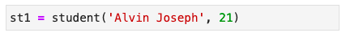
Instantiating Objects
Instantiating objects means creating instances of a class. To instantiate a class, call the class like a function, passing arguments as defined in the __init__ method.
Example: Create an object for student class
Here st1 is an object of the class student.
The values passed to the class are the arguments defined in the __init__ method.
Notes:
Instructor Notes:
Instantiating objects refers to the process of creating instances or objects of a class. In Python, you can create multiple objects from a single class, each having its own set of attributes and methods.

Slide 55
Deleting Instances
In Python, you do not need to explicitly delete an object after use.
Python automatically releases memory when all references to an object are no longer needed.
Python uses automatic garbage collection.
Unlike other programming languages (e.g., C++), destructors are not needed in Python classes.
Notes:
This slide is self explanatory.

Slide 56
Attributes
Attributes are non-method data stored by objects.
Object: Dog
Identity | Attribute
Name of the dog | Breed
 | Age
 | Color
Notes:
Instructor Notes:
In Python, the non-method data stored by objects are referred to as attributes. Attributes represent the characteristics or properties of an object and store the data associated with the object.

Slide 57
Types of Attributes
A Python object has two types of attributes:
Data attributes
Class attributes
Notes:
This slide is self explanatory.

Slide 58
Data Attributes
Characteristics of data attributes include:
Each instance of a class has its own variables.
Each instance has its value for each variable.
The __init__ method creates and initializes variables.
Data attributes are referred to inside the class using the self keyword.
Notes:
Instructor Notes:
Data attributes are owned by a specific instance of a class.
Each instance has its own set of values for data attributes.
Data attributes are referred to within the class using the self keyword.
The __init__() method creates and initializes data attributes.

Slide 59
Class Attributes
Class attributes are variables defined inside a class but outside any method. They have the following characteristic:
They can be accessed using the class name or an instance of the class.
They are shared by all instances of the class.
They can store constants, default values, or any other data that needs to be shared by all instances of the class.
They can be accessed from outside the class, which can lead to unexpected behavior.
Notes:
This slide is self explanatory.

Slide 60
Implementing a Class with Attributes and Methods
05
Overview:
This demonstration covers creating classes with attributes and methods in Python. You will learn how to define a class, declare attributes, create methods, instantiate objects, and access class attributes and methods through objects.
Note:
Please download the demo document from the Reference Material section to perform step-by-step execution.
Notes:
Instructor Notes:
Please demonstrate the actions specified on the slide. Additionally, encourage the learners to actively participate by performing the tasks along with you during the demonstration.
For further guidance, you can refer to the elaborated demo document.
Objective: In this demonstration, you will learn how to create a class and define methods and attributes.
Tasks to Perform:
Create a class
Declare the desired attributes
Create a method that displays the information
Initiate the objects
Access class attributes and methods through objects

Slide 61
Encapsulation
Notes:
Let's learn about encapsulation in Python.

Slide 62
Encapsulation
Encapsulation binds data members and functions into a single unit.
Features
It hides the state of a data object within a class, preventing unauthorized access.
It acts as a barrier that restricts direct access to variables and methods, also known as data hiding.
Notes:
Instructor Notes:
Encapsulation is defined as the wrapping up of data under a single unit. It is the mechanism that binds together code and the data it manipulates. Encapsulation is a process of binding data members and member functions into a single unit. Encapsulation is used to hide the values or state of a structured data object inside a class, preventing unauthorized access to them.

Slide 63
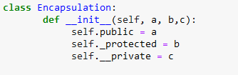
Encapsulation: Example
At a medical store, only the pharmacist has access to the medicines based on the prescription. This reduces the risk of taking medicine not intended for a patient.
Example
Notes:
Instructor Notes:
Example: Medical Store:
This example defines a `Encapsulation` class with a constructor method `__init__` that initializes three attributes: `public`, `_protected`, and `__private`. The `public` attribute is public, `_protected` is protected (intended for internal use), and `__private` is private (accessible only within the class). This demonstrates different levels of encapsulation.
When you go to the medical store and ask the chemist for the medicines, only the chemist has the access to the medicines in the store based on your prescription. The chemist knows what medicines to give you. This reduces the risk of you taking any medicine that is not intended for you.
Here medicine is the member variables, Chemist is the member methods, You are the external applications or piece of code.

Slide 64
Inheritance
Notes:
Let's look into inheritance in Python.

Slide 65
Inheritance
Inheritance is the process of forming a new class from an existing class or base class.
Example: A family has three members: a father, a mother, and a son.
Father (Base class)
Tall
Dark
Mother (Base class)
Short
Fair
Also known as super class
Son (Derived class)
Tall
Fair
Also known as sub class
The son is tall and fair, indicating he inherited these features from his parents. Inheritance also refers to superclass and subclass.
Notes:
Instructor Notes:
The mechanism of deriving a new class from the old class or base class is called Inheritance.
The class that inherits properties from another class is called Sub Class or Derived Class. The class whose properties are inherited by a sub-class is called Base Class or Super Class.
Explain with an example

Slide 66
Types of Inheritance
Single-level inheritance
A class can inherit from only one class.
Multilevel inheritance
A derived class is created from another derived class.
Hierarchical inheritance
A base class can have multiple subclasses inherited from it.
Multiple inheritance
A class can inherit from more than one class.
Notes:
Instructor Notes:
In single inheritance, a class is allowed to inherit from only one class.
In Multiple Inheritance, a class can inherit from more than one class.
In multilevel inheritance, a derived class is created from another derived class.
In hierarchical inheritance, more than one sub class is inherited from a single base class.

Slide 67
Inheritance: Single Level Inheritance
A class derived from one parent class is called single-level inheritance.
Parent class
Child class
Notes:
Instructor Notes:
In single-level inheritance:
The class that is derived from another class is called the "child" class or "derived" class.
The class from which the child class inherits is called the "parent" class or "base" class.

Slide 68
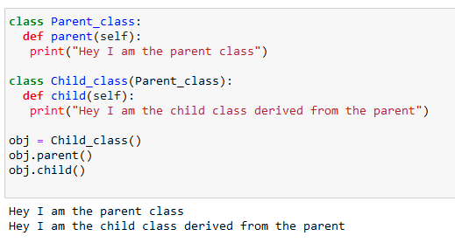
Single Level Inheritance: Example
Example
Notes:
Instructor Notes:
Explain with an example:
This code demonstrates inheritance in Python. The `Parent_class` defines a method `parent` that prints a message. The `Child_class` inherits from `Parent_class` and defines its own method `child` that prints a different message. An object of `Child_class` is created, and both the `parent` method from `Parent_class` and the `child` method from `Child_class` are called, demonstrating that the child class can access methods from the parent class.

Slide 69
Implementing Inheritance
05
Overview:
This demonstration covers single-level inheritance in Python. You will learn how to create a parent class, define attributes and methods, and inherit them in a child class. Additionally, you will explore how to extend functionality by adding unique methods to the child class.
Note:
Please download the demo document from the Reference Material section to perform step-by-step execution.
Notes:
Instructor Notes:
Please demonstrate the actions specified on the slide. Additionally, encourage the learners to actively participate by performing the tasks along with you during the demonstration.
For further guidance, you can refer to the elaborated demo document.
Objective:
To implement single-level inheritance in Python, where a child class inherits attributes and methods from a single parent class.
Tasks to Perform:
Create a parent class with attributes and methods.
Create a child class that inherits from the parent class.
Create objects of the child class and access the attributes and methods of the parent class.
Add a unique method to the child class and call it using the object.

Slide 70
Polymorphism
Notes:
Let's understand the concept of polymorphism in Python.

Slide 71

Polymorphism
Mother
Polymorphism comes from a Greek word meaning 'many shapes'.
Polymorphism is the ability of a message to be displayed in multiple forms.
Example: A woman can simultaneously be a mother, wife, teacher, sister, and friend.
Friend
Wife
Sister
Woman
Teacher
Notes:
Instructor Notes:
Polymorphism refers to the ability of an object to take on different forms or behave differently in different situations.

Slide 72
Types of Polymorphism
Polymorphism
Compile time
Runtime
Method overloading
Operator overloading
Method overriding
Notes:
Instructor Notes:
Explain the diagram
Method overloading: When there are multiple functions with same name but different parameters then these functions are said to be overloaded.
Operator overloading as evident from the name itself means the ability to overload the operator to provide extra functionality in addition to its real operational meaning.
Method overriding: it allows a derived class to provide its own implementation of a method that is already defined in its parent class. It involves redefining the method in the derived class with the same name and parameters.
The types of polymorphism are mentioned below:

Slide 73
Abstraction
Notes:
Let's look into the concept of abstraction in Python.

Slide 74

Abstraction
Abstraction allows the representation of complex systems or ideas in a simplified manner.
For example, when one presses a key on the keyboard, the relevant character appears on the screen. One doesn't have to know how this works. This is called abstraction.
Notes:
Instructor Notes:
Class abstraction means separating class implementation from the use of the class. The creator of the class provides a description of the class and let the user know how the class can be used. The user of the class does not need to know how the class is implemented. Abstraction also represents the needed information without presenting the details.
Explain with an example:
When you press a key on the keyboard, the relevant character appears on the screen.
It is not essential for you to know how exactly this works.
This is called abstraction.

Slide 75

Abstraction
In Python, abstraction works by incorporating abstract classes and methods.
Abstract methods do not have implementation in the abstract class. All implementation is done inside the subclasses.
An abstract class is a class specified in the code containing abstract methods.
01
Notes:
This slide is self explanatory.

Slide 76
Abstraction
In Python, abstraction works by incorporating abstract classes and methods.
Only an object of the derived class can access the features of the abstract class.
An abstract class can only be inherited.
01
Notes:
This slide is self explanatory.

Slide 77
Which of the following is NOT an OOP concept?
Inheritance
Compilation
Abstraction
Encapsulation
Notes:
Instructor Notes:
Correct Answer: B. compilation Explanation: There are four OOP concepts: Inheritance, Encapsulation, Polymorphism, and Abstraction.

Slide 78
File Handling in Python
Notes:
Let's delve into file handling in Python.

Slide 79

File Handling in Python
File operations are fundamental actions performed on files, including creating, reading, writing, and closing.
These operations are crucial for data manipulation, storage, and transfer in programming, and Python provides built-in functions and methods for handling these tasks efficiently.
Notes:
Instructor Notes:
File handling is an essential part of many programs and applications. Python provides built-in functions and methods for creating, reading, writing, and closing files. These operations are crucial for data manipulation, storage, and transfer.

Slide 80
Creating and Opening a File
To open a file in Python, use the open() function. If the file does not exist, opening it in write (w) or append (a) mode can create it.
Syntax:
file = open('example.txt', 'w')
Notes:
Instructor Notes:
For the detailed example, please refer to the notebook named Lesson_04_File_Handling_in_Python.

Slide 81
Reading from a File
To read the entire content of a file, use the read() method:
Syntax:
content = file.read()
print(content)
To read one line at a time, use the readline() method, and for reading all lines into a list, use readlines():
Syntax:
line = file.readline()
print(line)
lines = file.readlines()
print(lines)
Notes:
Instructor Notes:
For the detailed example, please refer to the notebook named Lesson_04_File_Handling_in_Python.

Slide 82
Writing to a File and Closing a File
Use the write() method to write a string to a file, and writelines() for a list of strings:
Syntax:
file.write('Hello, world!\n')
lines = ['First line\n', 'Second line\n']
file.writelines(lines)
Close a file after the operations are complete to free up system resources.
Syntax:
file.close()
Notes:
Instructor Notes:
For the detailed example, please refer to the notebook named Lesson_04_File_Handling_in_Python.

Slide 83
Implementing File Handling in Python
05
Overview:
This demonstration covers file handling in Python. You will learn how to read, write, and append data to files, read files line by line, and properly close files after operations.
Note:
Please download the demo document from the Reference Material section to perform step-by-step execution.
Notes:
Instructor Notes:
Please demonstrate the actions specified on the slide. Additionally, encourage the learners to actively participate by performing the tasks along with you during the demonstration.
For further guidance, you can refer to the elaborated demo document.
Objective: To understand file handling in Python, including reading, writing, appending, and processing files efficiently.
Tasks to perform:
1. Read a file
2. Write to a file
3. Append to a file
4. Read after writing
5. Read line by line
6. Write strings and close the file

Slide 84
Error Handling in Python
Notes:
Let's delve into error handling in Python.

Slide 85
Introduction to Error Handling
It is the process of managing errors or exceptions that occur during the execution of a program providing an appropriate message to the developer.
The program encounters unexpected situations like a missing file, invalid user input, or division by zero, and an error gets raised.
The program stops abruptly when these errors occur without error handling.
The program allows for managing errors gracefully, recovering from them, or displaying user-friendly messages, ensuring it runs more smoothly and reliably.
Notes:
Instructor Notes:
Walk through each bullet point explaining the importance of error handling:
First bullet: Mention common unexpected situations that could cause errors (e.g., missing files, invalid inputs, or divide-by-zero scenarios). Emphasize that when these errors occur, an exception is raised.
Second bullet: Explain that without error handling, the program would crash and stop executing, which would be undesirable.
Third bullet: Explain how error handling helps manage errors gracefully by allowing the program to either recover or display helpful error messages for the user.

Slide 86
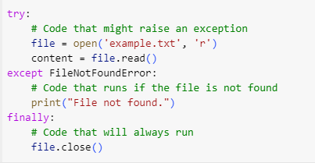
Error Handling in Python: Example
Python provides a way to manage errors using the below blocks:
try: This block contains code that might raise an exception (e.g., attempting to open a file that might not exist).
except: If the try block raises a specific exception (e.g., FileNotFoundError), this block will execute, handling the error gracefully.
finally: This block always runs, regardless of whether an exception occurred or not; it is used for clean-up actions, like closing files or releasing resources.
Notes:
Instructor Notes:
Introducing the example: opening a file, handling a potential error if the file isn’t found, and ensuring that the file is always closed.
Explain each block in the example:
try: This block attempts to open the file. If the file doesn’t exist, an exception will be raised.
except FileNotFoundError: If a FileNotFoundError occurs, this block catches the error and displays a message indicating that the file wasn’t found.
finally: No matter what happens, this block ensures the file is closed, whether it was successfully opened or not.

Slide 87
Implementing Error Handling in Python
05
Overview:
This demonstration covers error handling in Python. You will learn how to handle file-related errors, catch exceptions, display file contents if available, and ensure proper file closure regardless of errors.
Note:
Please download the demo document from the Reference Material section to perform step-by-step execution.
Notes:
Instructor Notes:
Please demonstrate the actions specified on the slide. Additionally, encourage the learners to actively participate by performing the tasks along with you during the demonstration.
For further guidance, you can refer to the elaborated demo document.
Objective: To understand error handling in Python using try, except, and finally blocks to manage file operations effectively.
Tasks to perform:
Prompt the user for a file name
Attempt to open and read the file contents
Catch the FileNotFoundError if the file does not exist
Display the file contents if the file is found
Ensure that the file is always closed, whether or not an error occurred

Slide 88
20
In this guided practice, you will create functions and classes in Python and implement single-level inheritance to understand the fundamentals of object-oriented programming. You will define functions for performing operations, create classes with attributes and methods, and apply inheritance to reuse code efficiently. By the end of this practice, you will have a working Python script where a child class inherits from a parent class, extending its functionality while demonstrating proper function integration.
Notes:
Instructor Notes:
Overview:
In this guided practice, you will apply the core concepts of Python functions, object-oriented programming, and inheritance. You will start by defining functions, creating classes, and then implementing single-level inheritance to demonstrate the relationship between parent and child classes. Through this practice, you will gain hands-on experience in structuring Python programs efficiently, improving reusability, and organizing code using functions and classes.
Tasks to Perform:
Step 1: Define and Use Functions
Create a Python function that performs a basic mathematical operation (e.g., addition, subtraction).
Define a function with positional and keyword arguments to demonstrate argument passing.
Implement a function that returns multiple values and call it in the main program.
Step 2: Create a Class and Use Methods
Define a parent class with attributes (e.g., name, age) and a method to display the details.
Create an instance of the parent class and access its attributes and methods.
Step 3: Implement Single-Level Inheritance
Create a child class that inherits from the parent class and extends its functionality.
Override a method in the child class to add new behavior while reusing the parent class's method using super().
Create an instance of the child class and demonstrate method overriding and inheritance.
Step 4: Integrate Functions with Classes
Call a function inside a class method to process data dynamically.
Create a function that returns an instance of a class, demonstrating real-world use cases.

Slide 89
Functions enhance code reusability, improve argument handling, and manage scope efficiently.
Generators and lambda functions enable optimized performance and concise code execution.
Object-oriented programming organizes code using classes, objects, and inheritance for better structure.
File operations facilitate reading, writing, and parsing data, including CSV files.
Error handling ensures code stability by managing exceptions and preventing failures.
Notes:
Mode: Sync
Estimated duration: 5 mins
Type: Instructor-led activity

Slide 90
Notes:
Mode: Sync
Estimated duration: 5 to 10 mins
Type: Whole-Group Activity

